Slide 1
Predicting Consumer Tastes using Web Data Analysis for Gap Inc.
HARSHRAJ JADEJA
JINXIN REN
SATHWIK KANUKUNTLA
SOHAM AGARWAL

Slide 2
Introduction

Slide 3
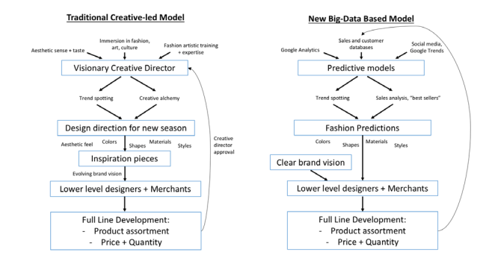

Problem Statement - GAP Inc.
Predicting Consumer Tastes with Big Data at Gap
Slow Growth in Core Markets
Competition
Rise of E-commerce
Rise of Fast Fashion
Heavy Discounting
Gap's Brand Identity...
Challenges:

Slide 4
Our Workflow
I. Problem Statement
II. Analysis
Qualitative
Literature review
Consumer affairs
Google Trends analysis
Quantitative
Redditt
Amazon
Google shopping
III. Big data in marketing strategy
IV. Art vs Science in GAP
Macy's - Competitive
Steps followed in the analysis
Key highlights from Literature Review:
“Gap’s market value has shrunk to about $10 billion, from roughly $40 billion at its 2000 peak and revenue has stalled at about $16 billion — flat from a decade ago, the WSJ Dec 2016”. As Gap Struggles, Its Analytical CEO Prizes Data Over Design - WSJ
“Orders at Gap require corporate approvals, while Zara permits an employee or agent to authorize new stock on the spot, according to a supplier who makes garments for both companies.” Gap learns a few things from Zara — me too | by Mark Kolier | Medium
“The loosely organized, data-driven approach has benefited some of Gap’s biggest rivals, including Zara, which has crushed Gap with the help of cheap fashion retailers including H&M and Uniqlo, and its understandable why Peck would want to adopt it.”Gap's CEO, Art Peck, missed the brand's biggest problem when he called creative directors "false messiahs" (qz.com)

Slide 5
Qualitative Analysis

Slide 6
Data Driven Creative Process - Our analysis
Google Trends
Objective: To understand top trends across 8 clothing categories in clothing in the US, given the GAP has implemented big data strategy
Identifying best keywords that fit into the GAP Inc. category based on GAP’s listing on Amazon
Using the identified categories as keywords to collect data from Google trends
Analyzing below 4 trending parameters
Trending queries
Most searched queries
Most searched topics
Tops state searching for keyword
Sample summary of the insights to strategize the product
Category | Top Query trending | Top searched queries | Top searched topics | Top state searching
Shirts | Obvious shirts | Mens shirts | Sleeve | Mississippi
Tops | hi tops los feliz | High tops | Zipper | New York
Jeans | 545 jeans | Black jeans | Bell-bottom | New York
Pants | dry sweat tucked tapered pants | Cargo pants | Cargo | New York
T-shirts | calvin klein mens t-shirts | t-shirts | Sleeveless | South Dakota
Polo | polo tech fleece | Ralph lauren | Ralph Lauren | New York
Tanks | mega man x sub tanks | Helium tanks | Helium | Mississippi
Shorts | sec roll call week 4 | Youtube shorts | YouTube shorts | Louisiana
Joggers | puma joggers mens | Joggers’ pants | Trousers | New Jersey
Jackets | tony alamo | Women swaeters | Winter | New York
Conclusion: GAP Inc. can make use of google trends to analyze the top trends for each clothing category to stay ahead of competition in identifying the products that can be in demand

Slide 7
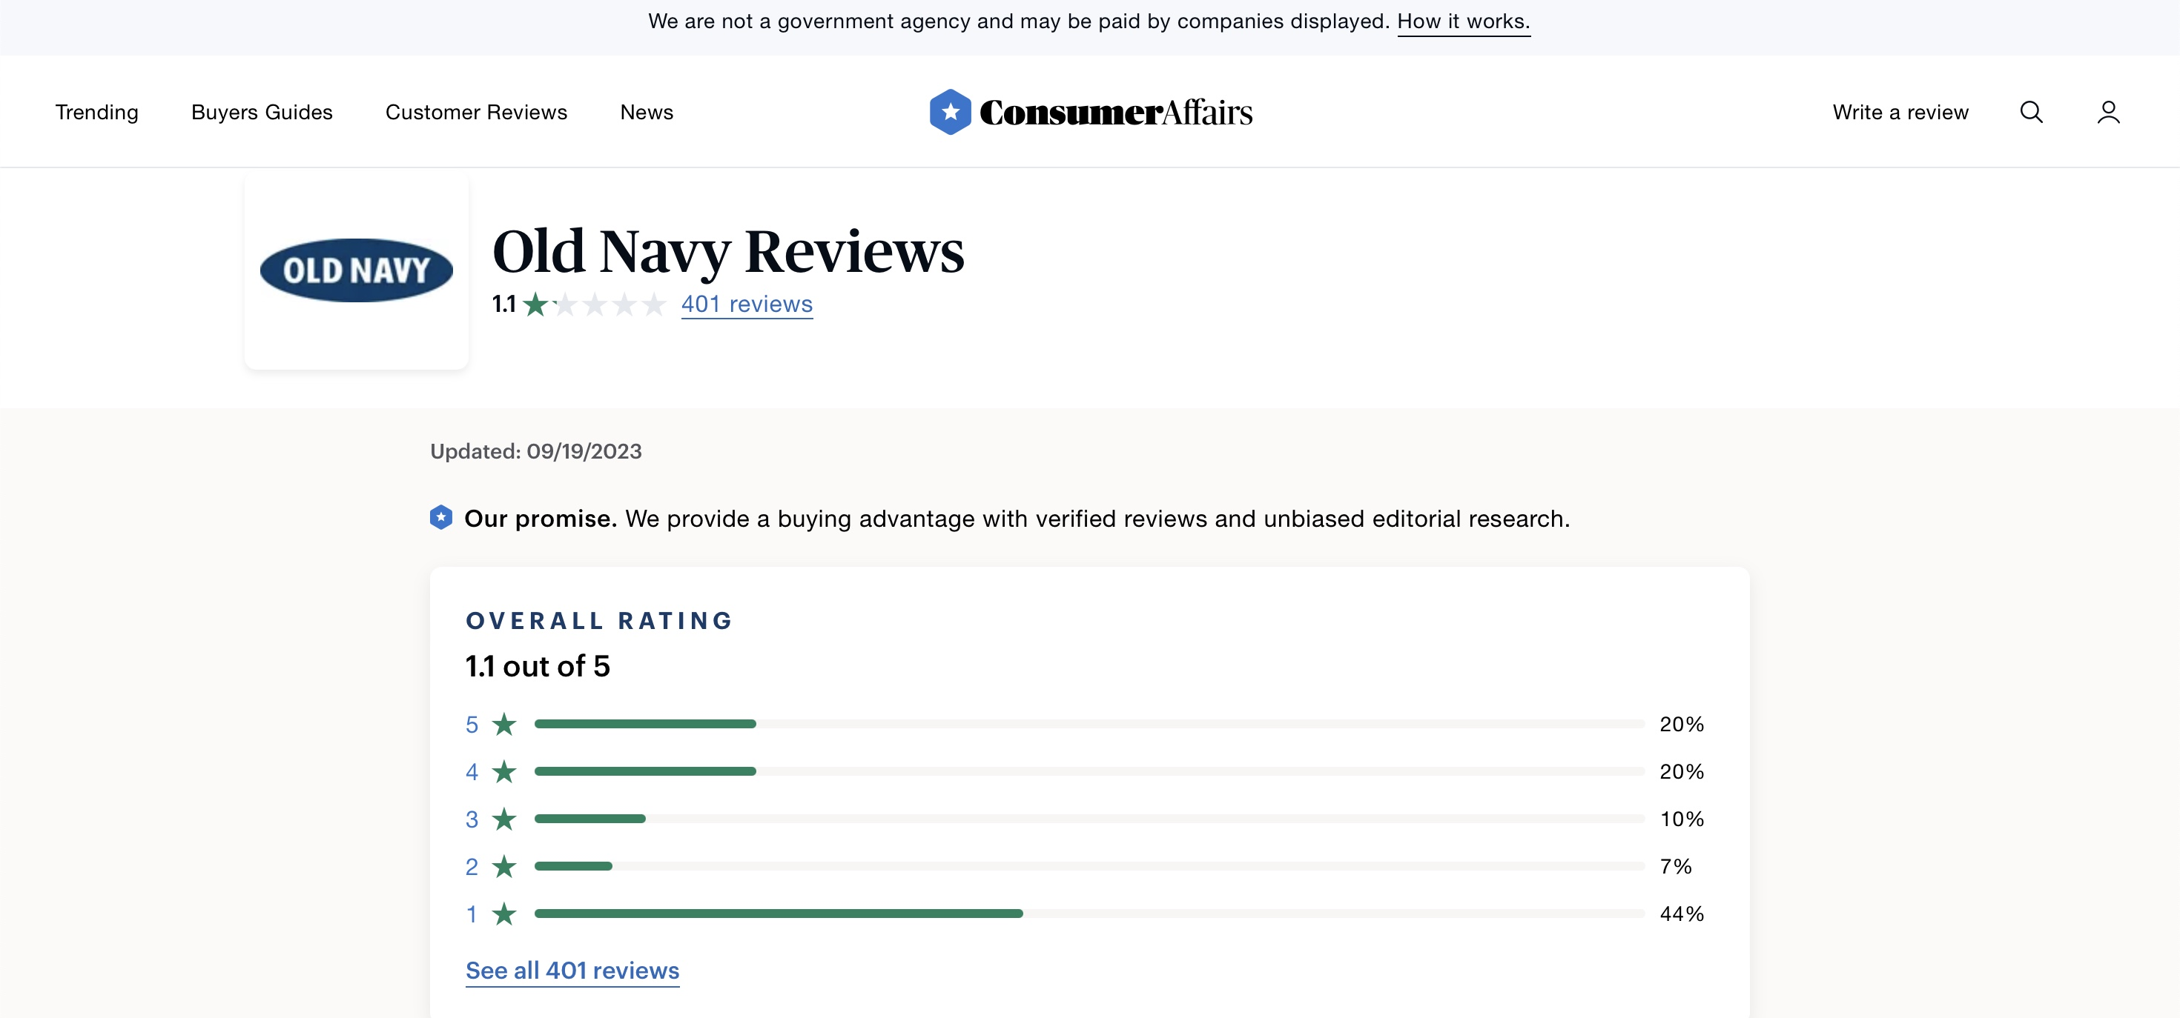
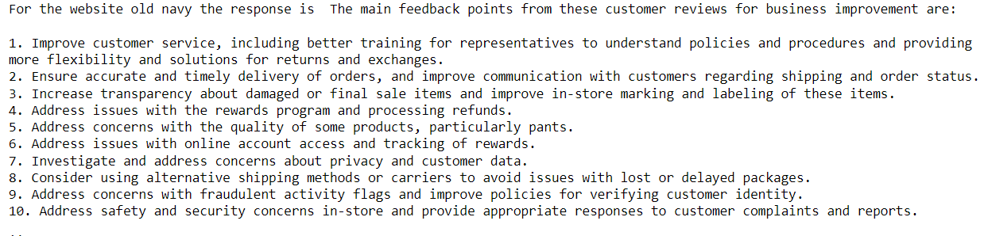
Data Driven Creative Process - Our analysis
ConsumerAffairs
Scraped the customer reviews for Old Navy, Gap & Banana Republic from ConsumerAffairs
Utilized the GPT-3.5 model to identify popular fashion trends in the feedback
Organized the findings and saved them in a .docx file
Provides firms with valuable insights into customer preferences to align their clothing offerings with trends
Conclusion: The 3 companies can use insights from Consumeraffairs.com to improve customer service and products.

Slide 8
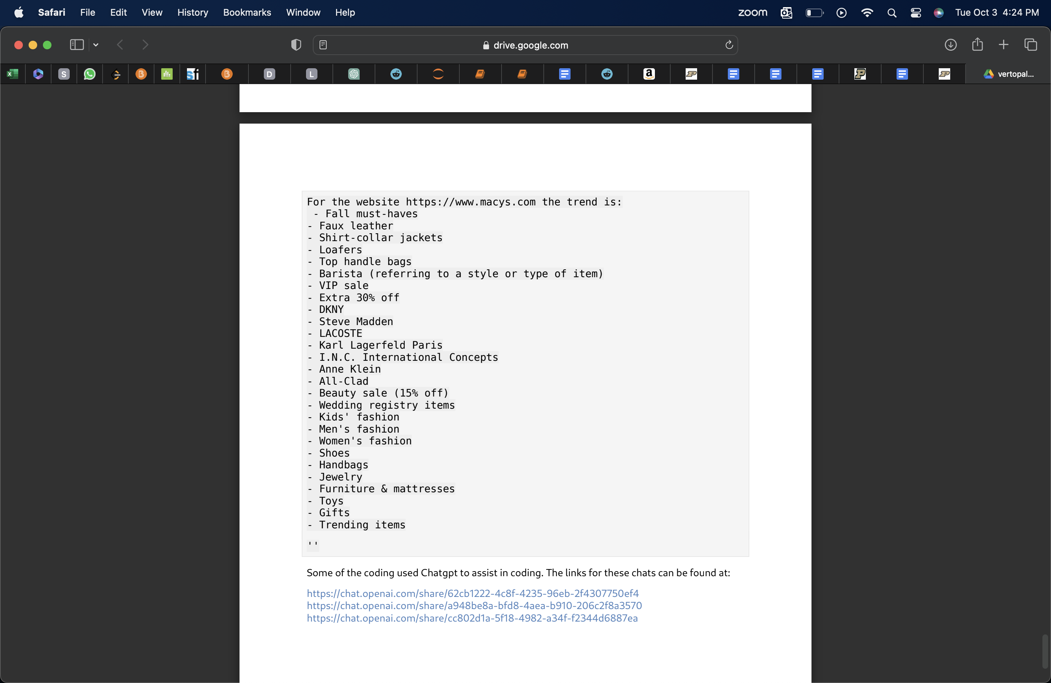
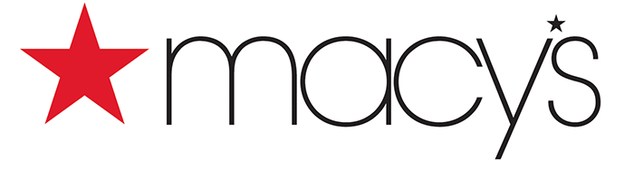
Data Driven Creative Process - Our analysis
MACY – Competitor Analysis
Objective: To monitor the pricing strategies, trends, best-selling products and promotions of the competing brands
Used Selenium to extract content from competitors' websites, including paragraphs, headers, links, spans, articles etc.
Employed ChatGPT to analyze the extracted content and to provide insights into the latest fashion trends and popular items mentioned
The trends identified by ChatGPT are recorded in a .docx file for further analysis and presentation
Conclusion: All the three brands can efficiently combine web parsing and AI-powered natural language processing to stay updated on trends within the fashion industry
Future action items: To ensure that the keywords scraped are relevant to our use case. For example, to avoid keywords such as ‘Trending items’ etc.

Slide 9
Quantitative Analysis

Slide 10
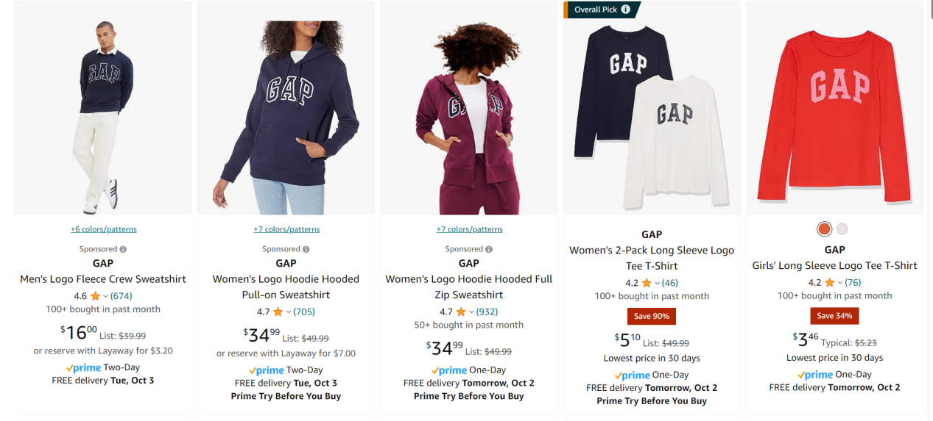
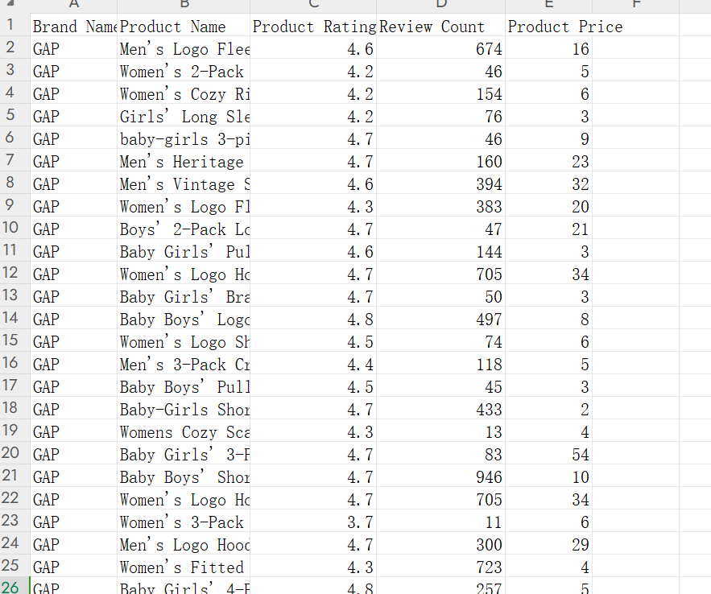
Data Driven Creative Process - Our analysis
Amazon
Comparison
Sales data from the direct partner: Amazon
What’s the most popular product on Amazon? Do the top 10 best sellers on Amazon match what GAP predicted based on its prediction model?
By comparing prediction result with real sales data on Amazon, we can acquire insights into whether the big data approach work for all 3 brands.
Gap has more predominance on amazon when compared to Banana republic and Old Navy

Slide 11
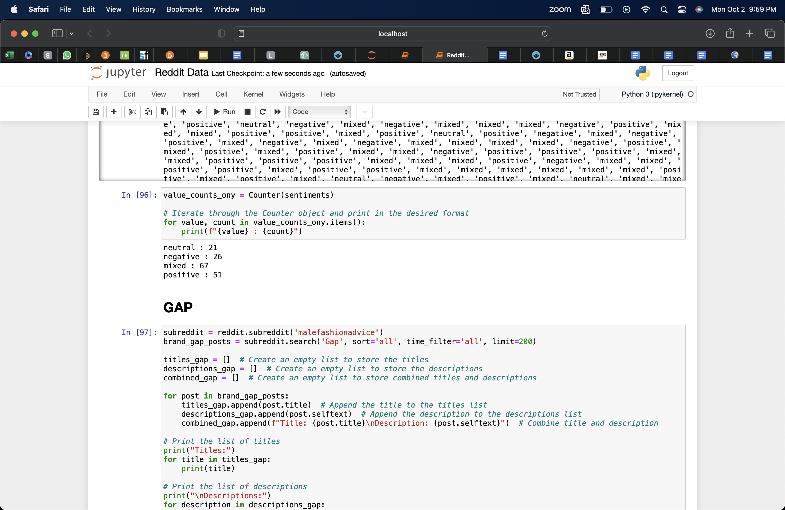
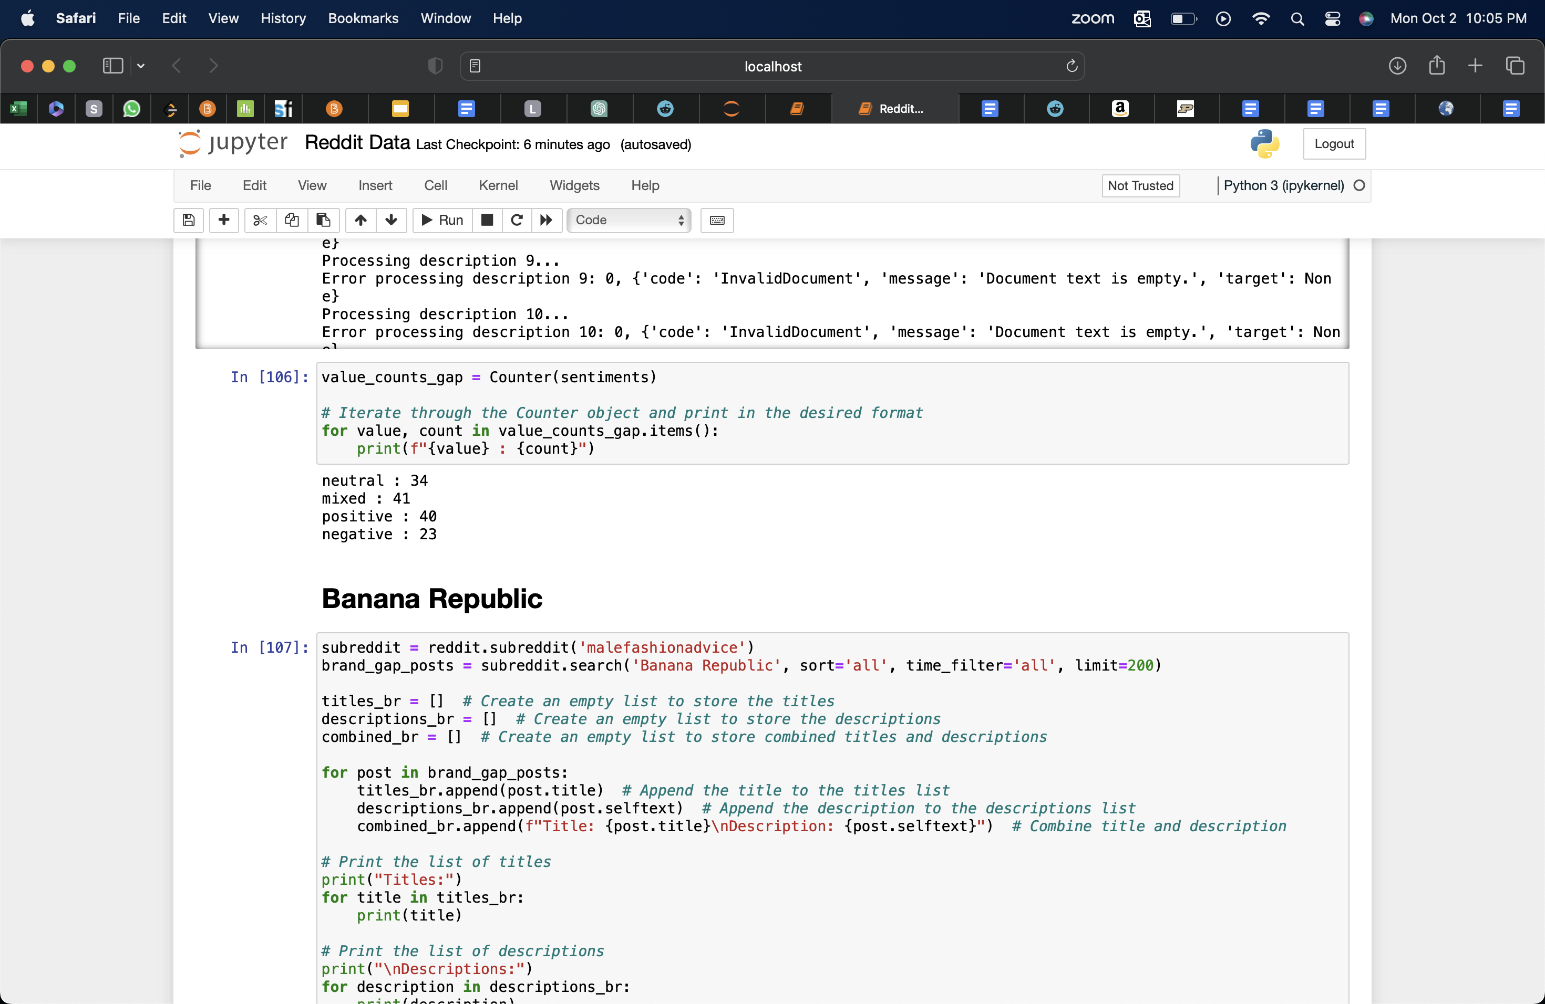
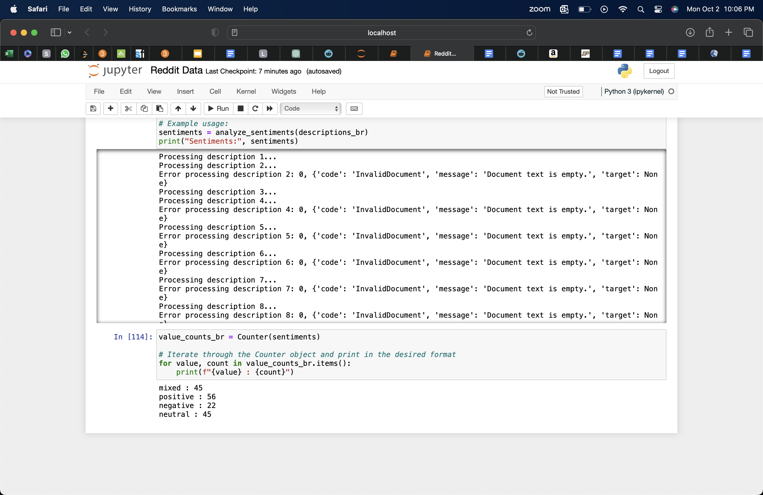
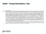
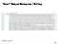
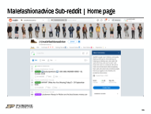
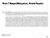
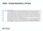
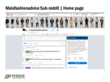
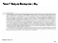
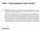
Data Driven Creative Process - Our analysis
Reddit – Sentiment Analysis
Objective: To understand sentiments of the consumers from one of the biggest sub-reddit ‘malefashionadvice’ for the three brands Gap, Old Navy & Banana Republic
Collected post descriptions from the Reddit "malefashionadvice" subreddit, specifically targeting
Gap
Old Navy
Banana Republic
Conducted sentiment analysis using Azure API post assigning scores to specific keywords
Aggregated sentiment scores to identify distinct brand-specific trends for each of the three brands
Summary of the sentiments scores generated from the sample data
Old Navy GAP Banana Republic
Conclusion: All the three brands can make use of the sentiment analysis of reddit to understand the sentiments of the consumers and make business decisions accordingly
Future action items: Narrowing down the approach by scrapping other gender specific, location specific and product specific sub-reddits

Slide 12
Data Driven Creative Process – Our analysis
Google Shopping – Regression Analysis
Objectives:
Understand how factors like price, discount, promotions, no. of reviews, store category, seller, and product category influence the product rating, assuming GAP Inc. has incorporated big data strategy
Evaluate whether the same big data strategy work for all the 3 brands
Brand/Area | Observation | Comments/Recommendation
All 3 brands | Regression models are built with R-squared values = {GAP: 0.3, Old Navy: 0.394, Banana Republic: 0.39}. | Assumed: (Ratings ~ Price, Discount, No. of reviews, Promotion tag, Seller, Web store category, Product category)
GAP | For unit increase in discount there is 0.54% increase in product rating Ratings are not significantly impacted by most of the seller, but Walmart with negative effect | Users preview GAP products to be overpriced for the given quality. More products listed in Walmart can reduce the overall ratings
Banana Republic | Listing products on Amazon is positively impacting the product Ratings are most negatively affected “Tops” category with -0.38 slope | Amazon is the best suggested platform “Tops” categories to be evaluated
Old Navy | Jeans categories have the most negative affect on rating with -0.24 slope | Jeans category can be strategized based on BCG matrix
Hypothesis testing | All 3 brands are affected differently by independent variables like price, discount, no. of reviews, seller, and product category. | Customize big data strategy for each brand
Approach:
Data collection
Cleaning data
Building regression models
Analyzing the effect of variables on rating
Evaluating regression model
Hypothesis testing across brands
Future Scope: As not many people give rating, building regression model based on demand as dependent variable can be more effective

Slide 13

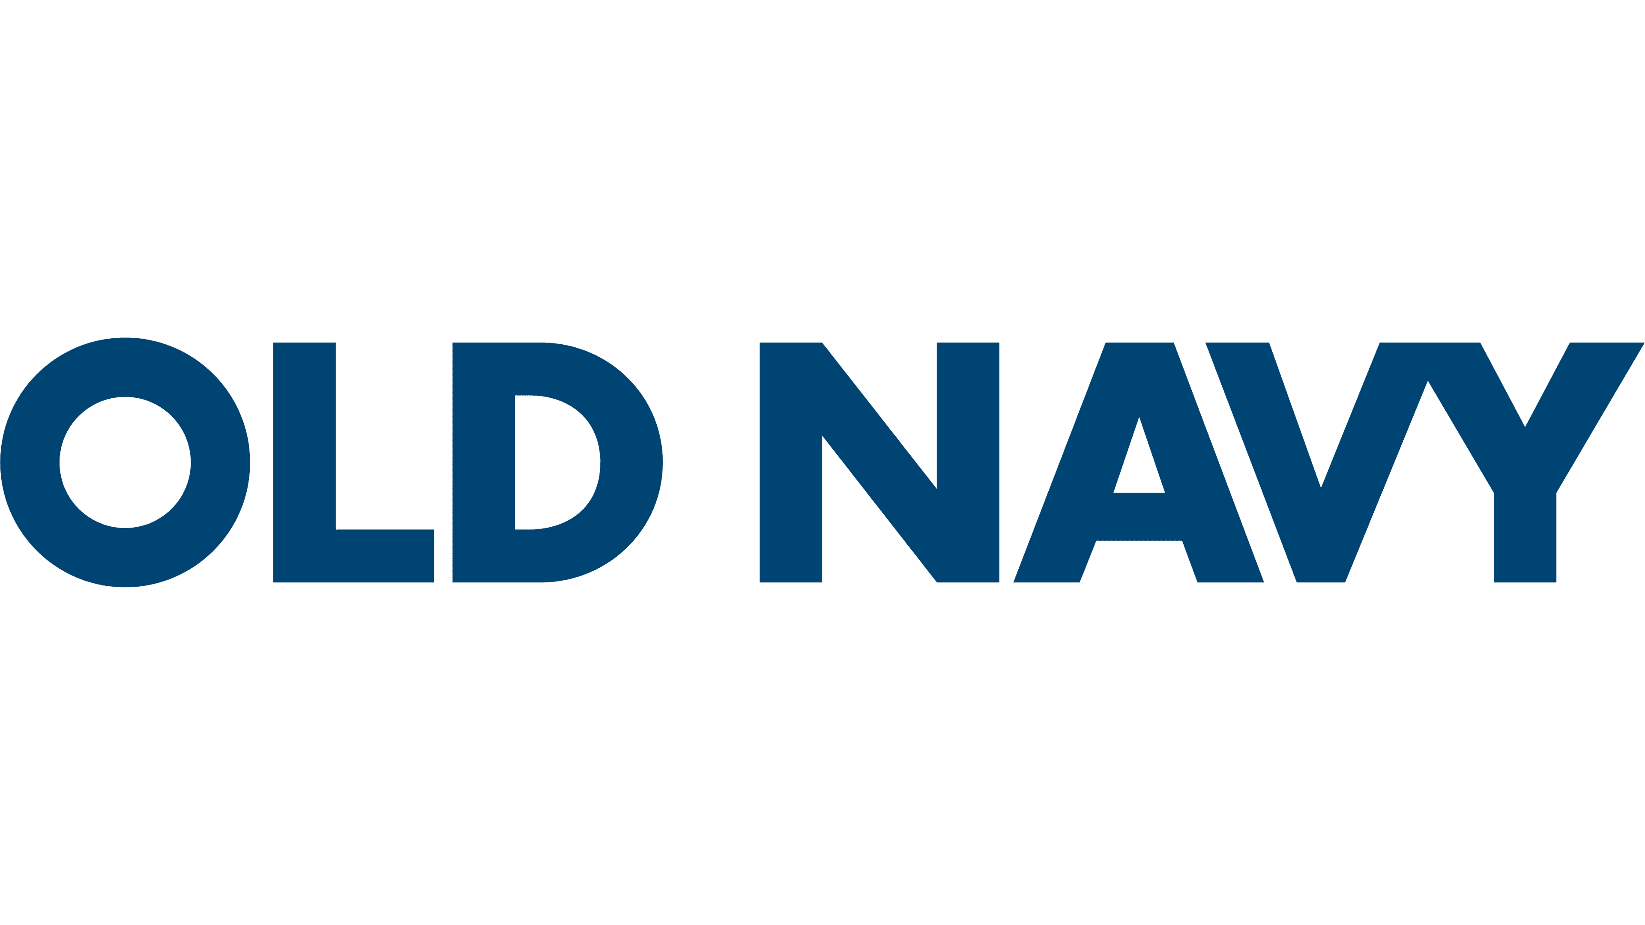

Overview- Approach for the 3 businesses
Which brands are served better or worse?
The role of big data on the basis of in-depth analysis:
All brands in our individual analysis above show the potential to derive actionable insights.
Gap has the biggest opportunity to gain insights from their online store on amazon.com. This could give them an edge.
Quantitative and qualitative data can be used in real time to inform decision makers.
The role of big data on the basis of online research:
Researching for more methods online, we discover: Old Navy might have a favorable ground due to its broader customer base. Banana Republic might face limitations due to its high-income consumer focus.
Luxury brands Banana republic have a significant art factor. This would require a human touch to differentiate themselves.
Old Navy's is heavily dependent on offline sales too, so metrics other than big data can be useful.

Slide 14
Big Data in Marketing
Art vs Science
Context: In marketing, the interplay between art and science has evolved significantly. The role of art versus science in marketing →
Art: Branding, Customer experience, emotional engagement
Science: Decision making, precision, scalability, trend analysis
GAP's Perspective: From GAP's point of view, prioritizing a science-based approach advantageous. Several factors make this approach compelling are as follows:
Case examples
Aspect | Amazon | Sephora
Big data utilization | Personalized recommendations Pricing optimization demand forecasting | Tailor product recommendations and promotions
Case Example (2017) | Used the "Recommendation Engine" to analyze customer data | Introduced the "Color IQ" system, enhancing customer satisfaction
GAP’s Potential | Trend insights and individual preferences Identify emerging fashion trends via social media monitoring | Personalized recommendations Develop virtual try-on tools Monitor real-time fashion trends
Customer-Centricity
Trend Analysis and Design
Clarity in Target Audience
Digital Transformation
Customer Tracking
Dynamic Fashion Industry
Conclusion: In an industry characterized by rapid change and evolving consumer preferences, data-driven insights empower GAP to respond effectively, create a personalized shopping experience, and maintain its competitive edge in the fashion retail sector.
Notes:
In today’s world, we delve into marketing's landscape in the era of big data and predictive analytics.
These tools are invaluable for precision targeting, personalization, and demand forecasting, making 'science' paramount in these areas. However, marketing is more than just data; it's about emotions, storytelling, and experiences, where 'art' shines in branding, customer engagement, and creating memorable experiences.
Take Amazon, for instance, whose personalized recommendations, pricing optimization, and demand forecasting are all powered by big data utilization, enhancing customer satisfaction. Similarly, Sephora's 'Color IQ' system is a prime example of using data to elevate the customer experience. However, GAP recognizes that 'art' still has a vital role, especially in branding, emotional engagement, and customer experience, ensuring that it strikes a balance between 'art' and 'science.' This equilibrium empowers GAP to respond effectively to the evolving market while fostering deep connections with consumers, maintaining its unique position in the fashion retail sector.

Slide 15
Balancing Art vs Science in Gap’s Marketing Strategy
Leveraging web data
By integrating data-driven insights(primary) and creative interpretation(secondary) into every aspect of the marketing strategy, Gap can effectively balance the art of emotional connection with customers and the science of precision and efficiency in marketing efforts.
Approach Recommended | Description | Impact example | Science | Art
Consumer Trends Analysis | Google Trends Amazon best sellers | Nike used trend analysis to identify athleisure trend, contributing to $32.4B revenue in 2016. | ✔
Competitor Monitoring | Competitor website scrapping (e.g.: Macy’s) | Walmart's analysis led to a pricing strategy, boosting revenue by 3.1% in 2017. | ✔
Customer Behavior Analysis | Customer behavior analysis (e.g. Redditt Sentiment analysis) | Amazon's optimization in 2015 resulted in a 1% revenue increase, adding $1.4B to their bottom line. | ✔
Personalization | Based on customer reviews, ratings, and sentiment | Netflix's strategy led to 10% increased retention and $8.3B revenue in 2016. | ✔ | ✔
Trend Utilization | Staying agile to identify fashion trends and creatively integrate them | H&M's approach in 2017 led to a 12% sales increase, reaching $25.2B. | ✔ | ✔
A/B Testing | Conduct data-driven A/B tests before product launch | Airbnb's tests in 2014 increased conversion rates by 20%, adding $240M in revenue. | ✔
Real-time Decision-Making | Use data analytics for inventory management (like Amazon, Walmart) | Walmart's approach in 2017 reduced out-of-stock instances by 10%, increasing revenue by $2.7B. | ✔
Customer Feedback Analysis | Google shopping Reddit Company websites | Starbucks enhanced its menu in 2016, resulting in a 4% sales increase, totaling $21.3B. | ✔ | ✔

Slide 16
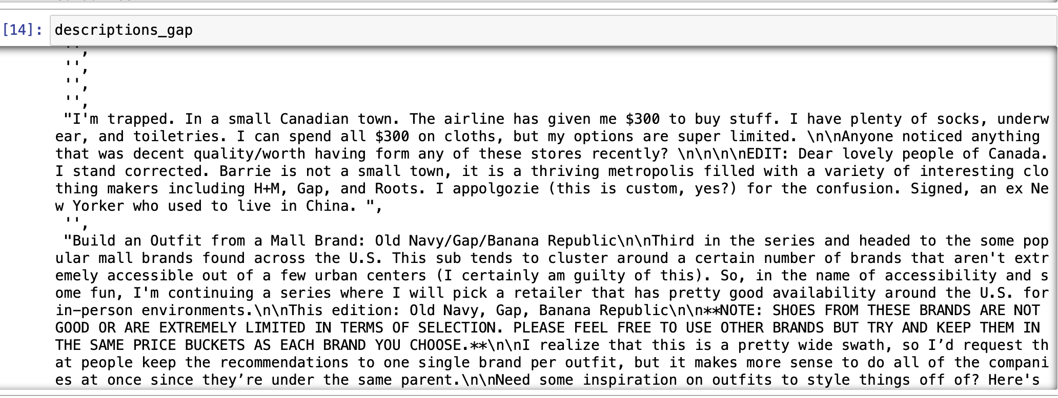
Limitations & Future recommendations
Scope of Improvement
Customers bogus reviews may bias the sentiment analysis hence, our further action items should include devising an algorithm to detect such reviews & avoid them in our analysis.
The number of customer reviews analyzed were limited due to API limits.
Some future scope would include comparing the results from the in-depth analysis with each other.
Some keywords results in the competitor analysis are not relevant to the business insights.
We can consider demand for google shopping instead of rating to build regressional models.

Slide 17
Thank You

Slide 18
Appendix

Slide 19
Feedback points | Old Navy

Slide 20
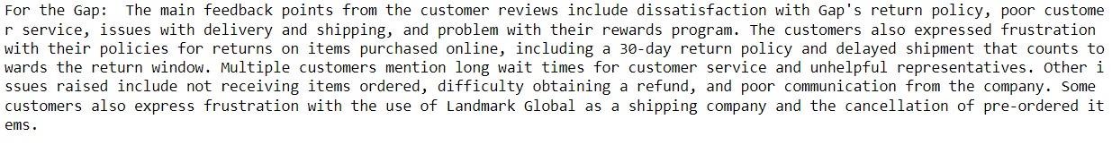
Feedback points | Gap

Slide 21
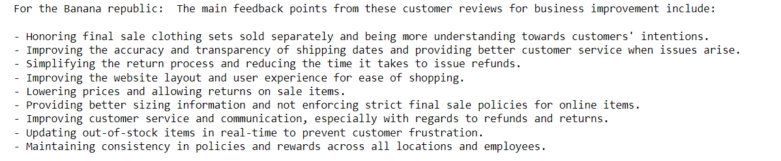
Feedback points | Banana Republic

Slide 22
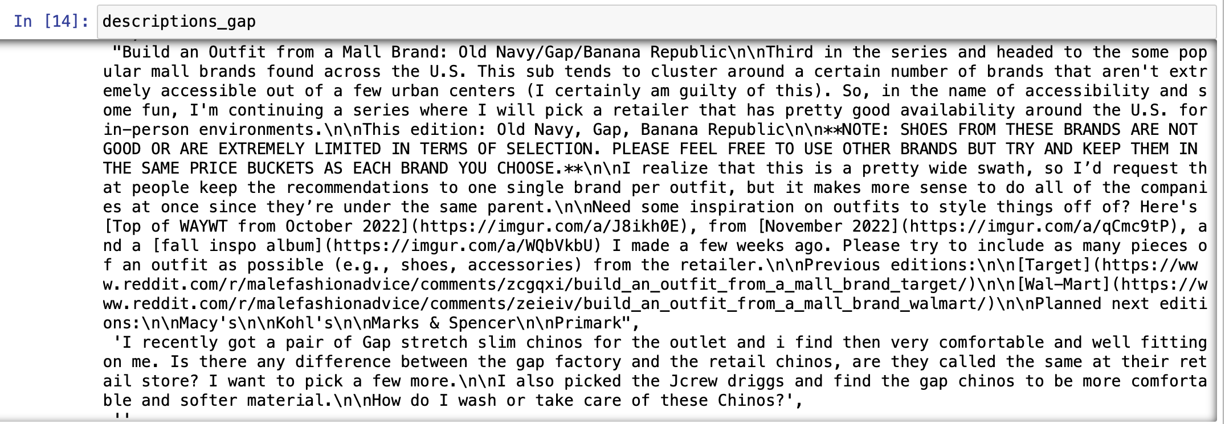
Reddit – Scraped Descriptions | Gap

Slide 23
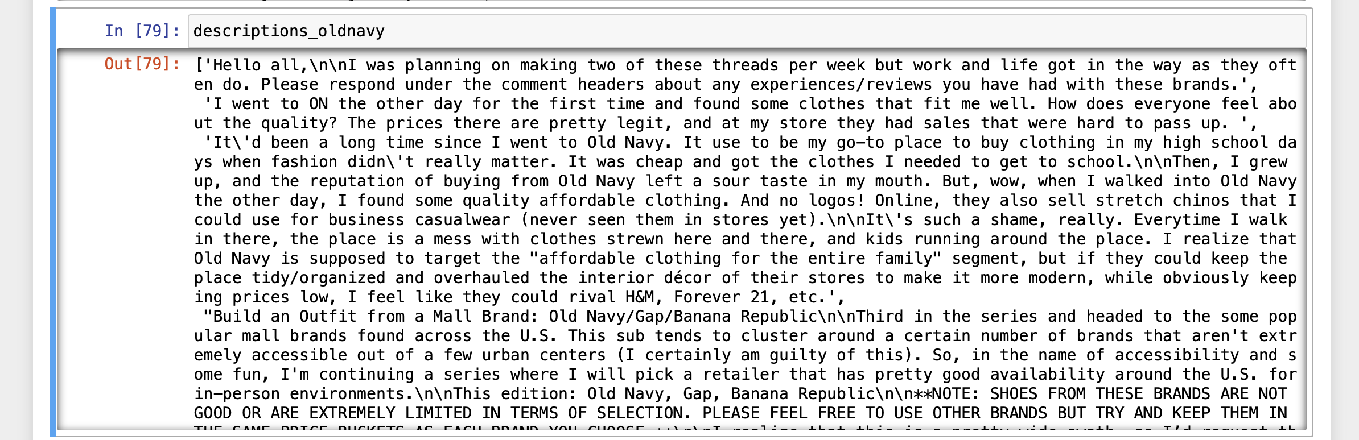
Reddit – Scraped Descriptions | Old Navy

Slide 24
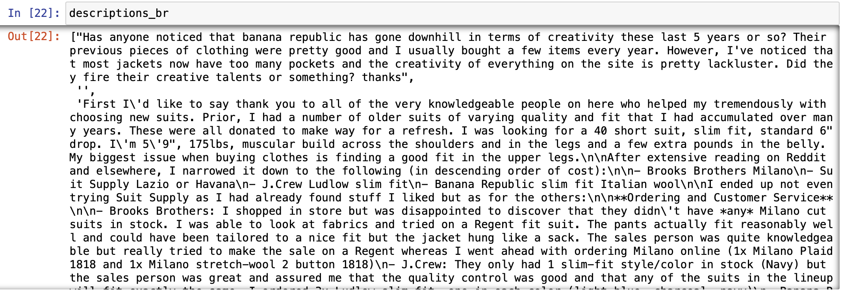
Reddit – Scraped Descriptions | Banana Republic

Slide 25
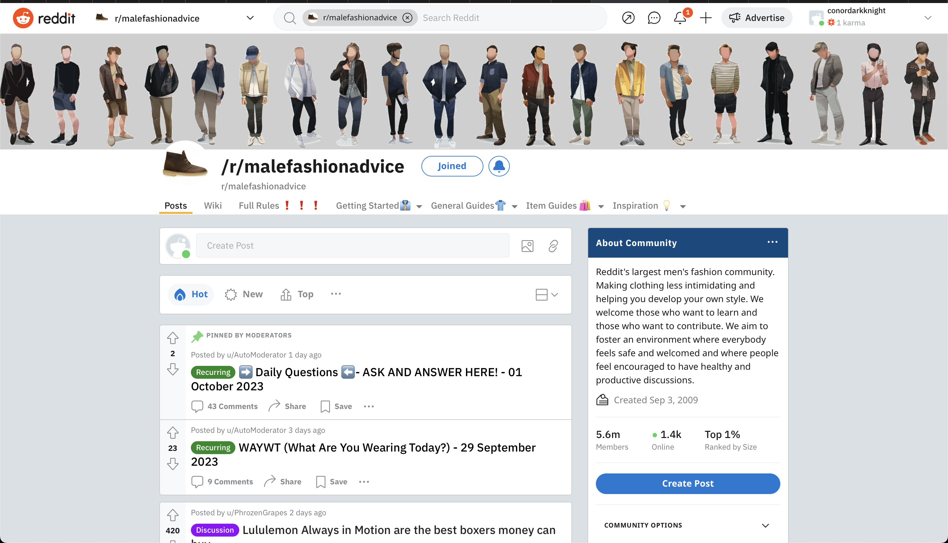
Malefashionadvice Sub-reddit | Home page

Slide 26
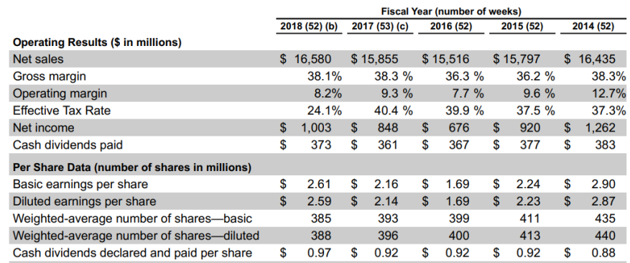
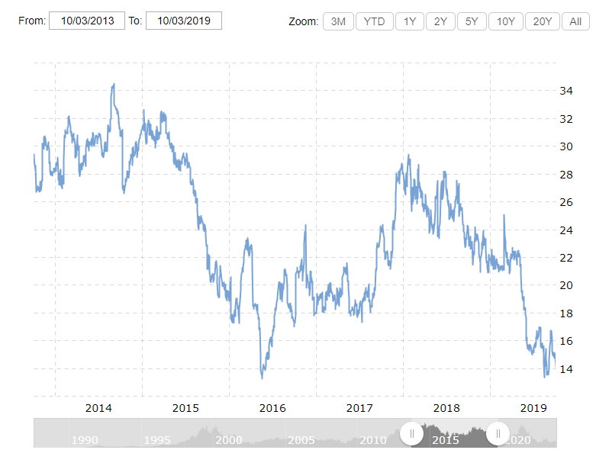
Peck’s decision
Tensions at play | Our approach
“Gap’s market value has shrunk to about $10 billion, from roughly $40 billion at its 2000 peak and revenue has stalled at about $16 billion — flat from a decade ago, the WSJ Dec 2016”. As Gap Struggles, Its Analytical CEO Prizes Data Over Design - WSJ
“Orders at Gap require corporate approvals, while Zara permits an employee or agent to authorize new stock on the spot, according to a supplier who makes garments for both companies.” Gap learns a few things from Zara — me too | by Mark Kolier | Medium
“The loosely organized, data-driven approach has benefited some of Gap’s biggest rivals, including Zara, which has crushed Gap with the help of cheap fashion retailers including H&M and Uniqlo, and its understandable why Peck would want to adopt it.”Gap's CEO, Art Peck, missed the brand's biggest problem when he called creative directors "false messiahs" (qz.com)
Art Peck is correct, and transformation is needed

